Slide 1
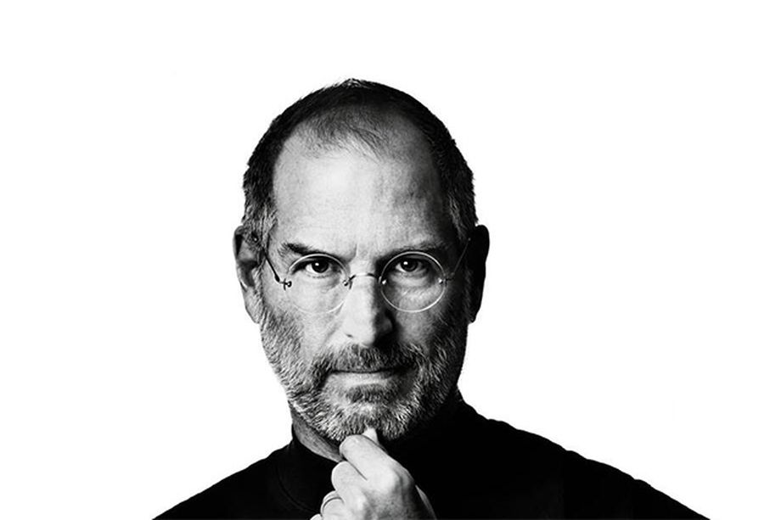
The Best Advice Steve Jobs Ever Gave
Listening/Reading (B1) Cloze Activity

Slide 2

Instructions
Open the embedded Word file.
Open the following website: https://www.naturalreaders.com/online/.
Copy and paste the text reader program.
  Adjust the speaker and text speed.
Play the text reader and have student follow along using the PPT slides.
Students should follow along and listen for the missing words.
Activity adapted from article (see LINK)

Slide 3
Entrepreneurs all over the globe admire Steve Jobs, and for good reason; he was a bold visionary who completely revolutionized the tech industry. Even today, many years after his death, people still _____ Steve Jobs a role model worth emulating. _____, we can continue to learn from him through past interviews and speeches. The _____ advice he provided will help guide the next generation of innovators.

Slide 4
To be successful, find work you’re passionate about
During the D5 Conference in 2007, an audience member asked Steve Jobs what _____ piece of advice he would give entrepreneurs on building valuable companies. Jobs answered the question _____ : in order to be successful, you must be passionate about the work you’re doing.
In giving his answer, Jobs acknowledged the fact that this piece of advice is widely circulated and generally _____ as true. The real insight came when Jobs explained the reason success is dependent upon loving what you do — because that’s the only way you’ll persevere.

Slide 5
As Jobs explained, building a business is not an easy task. To be successful, you must work hard and _____ repeated challenges over a long period of time without giving up. When faced with these ongoing challenges, most people will quit. But those who love what they’re doing will persevere because they’re driven by their _____, not by external rewards.

Slide 6
Let your curiosity and intuition lead you
In his commencement address at Stanford University in 2005, Steve Jobs emphasized the _____ of trusting your gut and following your curiosity. Jobs encouraged students to pursue their interests, even if they seem _____ at the time. He believed that much of his success could be attributed to this philosophy.
For example, Jobs took a class on calligraphy. He found the class fascinating but at the time it seemed to serve no practical purpose. It was only later, in looking back on his life, that Jobs recognized the importance of that calligraphy class; it gave him an _____ of great typography which he later applied when designing the Macintosh computer.

Slide 7
Jobs believed that curiosity and intuition are trustworthy _____. Even if you can’t see where each decision is leading, you must have _____ that your curiosity and intuition are guiding you along the right path.

Slide 8
Ignore the expectations of others
Steve Jobs repeatedly advised people to ignore the _____ imposed by others and create their own lives. In a 1994 interview with The Santa Clara Valley Historical Association, Jobs discussed the false nature of society’s boundaries and _____ his belief that people should question those limitations. He believed that people have the power to changes lives -- their own and those of others -- if they’re willing to challenge the _____.

Slide 9
Steve Jobs reiterated this point in his Stanford commencement address. In it, he said, “Your time is limited, so don’t _____ it living someone else’s life. Don’t be trapped by dogma -- which is living with the results of other people’s thinking. Don’t let the noise of others’ opinions drown out your own inner voice. And most important, have the _____ to follow your heart and intuition. They somehow already know what you truly want to become. Everything else is secondary.”

Slide 10
Overcome the fear of failure and take action
Steve Jobs discussed failure in his 1994 interview with The Santa Clara Valley Historical Association. In the interview, Jobs _____ calling Bill Hewlett, the co-founder of Hewlett-Packard, at his home in Palo Alto, California. Jobs -- who was only 12 years old at the time -- called to ask if Hewlett had any spare parts he could use to build a frequency counter. Hewlett not only gave Jobs the parts he _____, he also hired him to work on the assembly line building frequency counters the following _____.

Slide 11
Jobs used this example to demonstrate that success only comes when you’re willing to take action and go after what you want. Instead of _____ Hewlett’s response and making excuses, Jobs took a chance -- one that paid off. In the interview, Jobs states, “that's what separates the people that do things from the people that just _____ about them: you’ve got to act and you've got to be willing to fail.”

Slide 12
Remember there’s a deadline
Steve Jobs knew what it was like to be _____ aware of your own mortality. He was first diagnosed with cancer in 2003 but didn’t succumb to the disease until October of 2011. But even before his diagnosis, Jobs understood that every day is important because our time on this _____ is limited.
Jobs relayed this valuable piece of _____ during his 2005 commencement address. In it, Jobs describes how at the age of 17, he read a quote that would provide guidance throughout his life. The quote was, “If you live each day as if it was your last, someday you’ll most certainly be right.”

Slide 13
Jobs then illustrated how this quote helped shape his life by saying, “Since then, for the past 33 years, I have looked in the _____ every morning and asked myself: ‘If today were the last day of my life, would I want to do what I am about to do today?’ And whenever the answer has been ‘No’ for too many days in a row, I know I need to change _____.”

Slide 14
Activity
Work with a partner or in a small group.
Choose the advice that you like best.
Explain it using examples or information from your own life.
Share your explanation with your group.
To be successful, find work you’re passionate about
Let your curiosity and intuition lead you
Ignore the expectations of others
Overcome the fear of failure and take action
Remember there’s a deadline

Slide 15
Cloze Answer Key

Slide 16
Entrepreneurs all over the globe admire Steve Jobs, and for good reason; he was a bold visionary who completely revolutionized the tech industry. Even today, many years after his death, people still consider Steve Jobs a role model worth emulating. Thankfully, we can continue to learn from him through past interviews and speeches. The valuable advice he provided will help guide the next generation of innovators.

Slide 17
To be successful, find work you’re passionate about
During the D5 Conference in 2007, an audience member asked Steve Jobs what single piece of advice he would give entrepreneurs on building valuable companies. Jobs answered the question plainly: in order to be successful, you must be passionate about the work you’re doing.
In giving his answer, Jobs acknowledged the fact that this piece of advice is widely circulated and generally regarded as true. The real insight came when Jobs explained the reason success is dependent upon loving what you do — because that’s the only way you’ll persevere.

Slide 18
As Jobs explained, building a business is not an easy task. To be successful, you must work hard and overcome repeated challenges over a long period of time without giving up. When faced with these ongoing challenges, most people will quit. But those who love what they’re doing will persevere because they’re driven by their passion, not by external rewards.

Slide 19
Let your curiosity and intuition lead you
In his commencement address at Stanford University in 2005, Steve Jobs emphasized the importance of trusting your gut and following your curiosity. Jobs encouraged students to pursue their interests, even if they seem impractical at the time. He believed that much of his success could be attributed to this philosophy.
For example, Jobs took a class on calligraphy. He found the class fascinating but at the time it seemed to serve no practical purpose. It was only later, in looking back on his life, that Jobs recognized the importance of that calligraphy class; it gave him an understanding of great typography which he later applied when designing the Macintosh computer.

Slide 20
Jobs believed that curiosity and intuition are trustworthy guides. Even if you can’t see where each decision is leading, you must have faith that your curiosity and intuition are guiding you along the right path.

Slide 21
Ignore the expectations of others
Steve Jobs repeatedly advised people to ignore the limitations imposed by others and create their own lives. In a 1994 interview with The Santa Clara Valley Historical Association, Jobs discussed the false nature of society’s boundaries and stated his belief that people should question those limitations. He believed that people have the power to changes lives -- their own and those of others -- if they’re willing to challenge the status quo.

Slide 22
Steve Jobs reiterated this point in his Stanford commencement address. In it, he said, “Your time is limited, so don’t waste it living someone else’s life. Don’t be trapped by dogma -- which is living with the results of other people’s thinking. Don’t let the noise of others’ opinions drown out your own inner voice. And most important, have the courage to follow your heart and intuition. They somehow already know what you truly want to become. Everything else is secondary.”

Slide 23
Overcome the fear of failure and take action
Steve Jobs discussed failure in his 1994 interview with The Santa Clara Valley Historical Association. In the interview, Jobs describes calling Bill Hewlett, the co-founder of Hewlett-Packard, at his home in Palo Alto, California. Jobs -- who was only 12 years old at the time -- called to ask if Hewlett had any spare parts he could use to build a frequency counter. Hewlett not only gave Jobs the parts he requested, he also hired him to work on the assembly line building frequency counters the following summer.

Slide 24
Jobs used this example to demonstrate that success only comes when you’re willing to take action and go after what you want. Instead of fearing Hewlett’s response and making excuses, Jobs took a chance -- one that paid off. In the interview, Jobs states, “that's what separates the people that do things from the people that just dream about them: you’ve got to act and you've got to be willing to fail.”

Slide 25
Remember there’s a deadline
Steve Jobs knew what it was like to be constantly aware of your own mortality. He was first diagnosed with cancer in 2003 but didn’t succumb to the disease until October of 2011. But even before his diagnosis, Jobs understood that every day is important because our time on this planet is limited.
Jobs relayed this valuable piece of wisdom during his 2005 commencement address. In it, Jobs describes how at the age of 17, he read a quote that would provide guidance throughout his life. The quote was, “If you live each day as if it was your last, someday you’ll most certainly be right.”

Slide 26
Jobs then illustrated how this quote helped shape his life by saying, “Since then, for the past 33 years, I have looked in the mirror every morning and asked myself: ‘If today were the last day of my life, would I want to do what I am about to do today?’ And whenever the answer has been ‘No’ for too many days in a row, I know I need to change something.”

