Slide 1
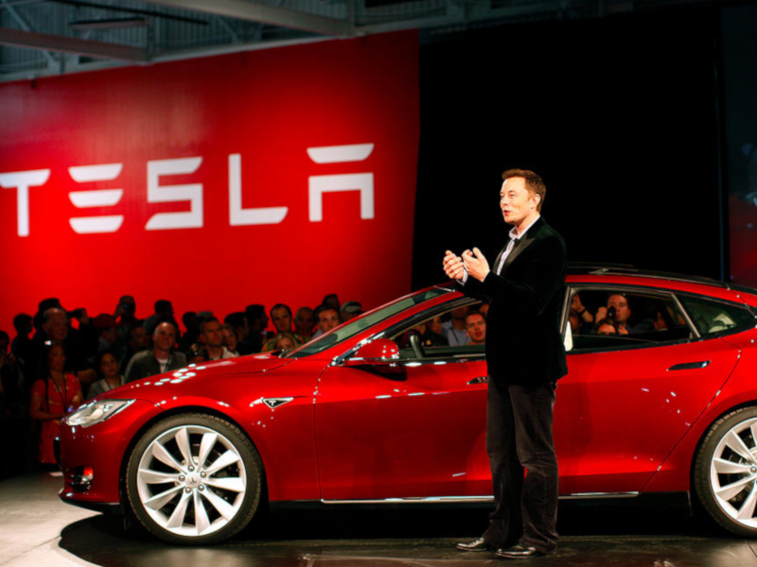
The Elon Musk Interview Question
Reading (B2) and Speaking Activity

Slide 2
Elon Musk always asks the same job interview question to catch people who are not honest
Who is Elon Musk?
What is a Tesla?
Why might people want to work for him?
What do question do you think he asks?
Activity adapted from article (see LINK)

Slide 3
Tesla CEO Elon Musk hires plenty of people thanks to his successful business empires, and he's revealed he looks for proof of a person’s special ability.
However, Musk is not interested in which school a potential employee attended or even their level of education.
“There’s no need even to have a college degree at all, or even high school," Musk said during a 2014 interview.
Instead, the father-of-seven looks for "evidence of exceptional ability" when it comes to hiring new staff.
What’s the difference between successful, special, potential, and exceptional?

Slide 4
Of course, it's easy for someone to lie on their CV or about their achievements, but Musk has a question that is designed to catch dishonest people.
Musk admitted he asks each candidate he interviews the same question: "Tell me about some of the most difficult problems you worked on and how you solved them.”
How might this question be useful for catching dishonest people?

Slide 5
A published study provided several approaches to spotting liars based on a job interview technique that supports Musk’s question.
One such approach is called “Asymmetric Information Management” (AIM) and is designed to provide an interviewee with a clear means to prove their innocence or guilt to a listener by providing detailed information.
One of the studies author’s wrote that small details are very important and can provide interviewers with facts to check and witnesses to question.
interviewee: a person who is interviewed
interviewer: a person who interviews someone

Slide 6
The studies author wrote that if the interviewee provides longer, more detailed information about the event, then the interviewer will be better able to detect if they are telling the truth or lying.
A dishonest person thinks providing more information will make it easier for the interviewer to detect their lie, so instead, they provide less information.
Musk said, “I want to make sure if there was some significant accomplishment, were they really responsible, or was someone else more responsible? Usually, someone who really had to struggle with a problem, they really understand the details, and they don’t forget."
Do you think the AIM approach really works? Why or why not?

Slide 7
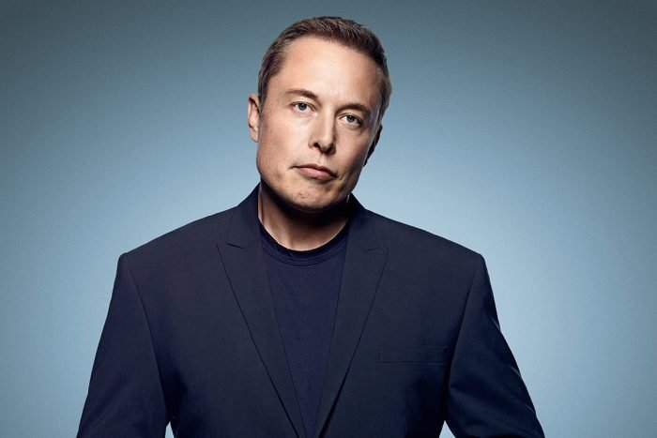
“So…tell me about one of the most difficult problems you worked on and how you solved it.”

Slide 8
Activity
Work in a small group.
Take turns answering Elon Musk’s interview question.
Decide if you will tell the truth or lie.
  If you tell the truth, talk about a problem that you really solved.
  If you decide to lie, talk about a problem that happened to someone else but pretend that it happened to you.
After you give your answer, your group members should decide if you told the truth or lied to them.

