Slide 1
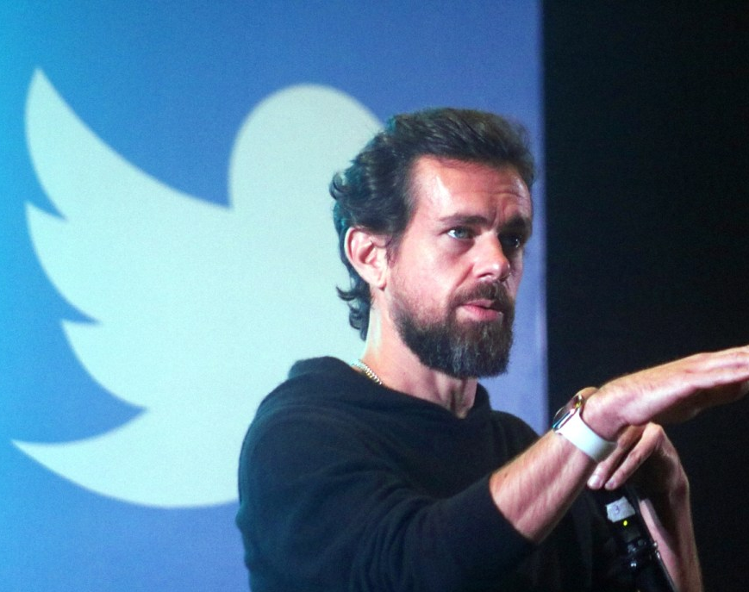
Here’s the advice Twitter CEO Jack Dorsey would give his 20-year-old self
Reading (B2) and Writing Activity

Slide 2
Predicting
What do you think his advice will be?
Activity adapted from article (see LINK)

Slide 3
When you’re running two companies, balance is important — but for the CEO of Twitter and Square, it didn’t always come naturally.
In fact, if he could give his younger self one piece of advice, it would be to find a healthier work-life balance.
“When I was young I didn’t understand the value of exercise or health and how that affected my intellect,” he said. “I think it was useful for me to go to all the extremes to find the balance I have now, but I wish I focused more on being healthier in the past.”
Today, the self-made billionaire maintains balance by sticking to a more structured schedule. “I look to build a lot of steady routine,” he said in a 2015. “Same thing every day.”
Do you think that this is good advice? Why or why not?

Slide 4
Dorsey’s routine involves waking up at 5 a.m., meditating for half an hour, and doing a seven-minute workout three times through — all before starting his workday.
“A healthier lifestyle ultimately makes me more creative and allows me to think more cohesively,” he said.
Dorsey isn’t the only successful person who values his health. According to author Thomas C. Corley, who spent five years studying rich people, many of the wealthiest people exercise consistently.
Science backs Corley’s findings: Research suggests that working out can boost your memory, concentration and mental sharpness. Plus, many studies show that exercise is one of the most important habits you can develop to transform your life.
What might be some other important habits you can develop?

Slide 5
Activity
If you could give your younger self one piece of advice, what would it be?
Write a short email to your younger self.
Give your younger self one piece of advice.
After writing your email, be ready to share it with the class.

